Slide 1
Problem and Production System Characteristics
INT404

Slide 2
Problem Characteristics
Is problem decomposable into set of(nearly) independent smaller or easier sub problems?
Can solution steps be ignored or at least undone if they prove unwise?
Is the problem’s universe predictable?
Is a good solution to the problem obvious without comparison to all other possible solutions?
Is a desire solution a state of the world or a path to a state?
Is a large amount of knowledge absolute required to solve the problem, or is knowledge important only to certain the search?
Can a computer that is simply given the problem return the solution, or will the solution of problem require interaction between the computer and a person?

Slide 3
1. Is the problem Decomposable?
By this method we can solve large problem easily.
Ex: Decomposable problem
Symbolic Integration
∫ (x² +3x + Sin²x.Cos²x )dx
Can be divided to
Integral of x²
Integral of 3x
Integral of Sin²x.Cos²x, which can be further divided to (1- Cos²x). Cos²x ….

Slide 4
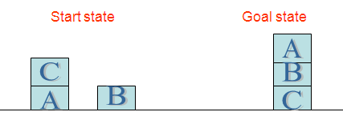
1. Is the problem Decomposable?
Ex: Non- decomposable problems
Block World Problem
Assume that only two operations are available:
CLEAR(x)[Block x has nothing on it]->ON(x,Table)[Pick up x and put on the table]
Clear(x) and Clear(y)->ON(x,y)[Put x on y]
ON(B,C) and ON(A,B)

Slide 5
2. Can Solution steps be ignored or undone?
Ignorable problem: in which solution steps can be ignored.
Ex:- Theorem Proving
Suppose we are trying to prove a mathematical theorem. We proceed by first proving a lemma that we think will be useful. Eventually, we realize that the lemma is not help at all.
Every thing we need to know to prove theorem is still true and in memory, if it ever was. Any rule that could have been applied at the outset can still be applied. All we have lost is the effort that was spent exploring the blind alley.

Slide 6
2. Can Solution steps be ignored or undone?
Recoverable problem: in which solution steps can be undone.
Ex:- The 8-Puzzle
The 8-puzzle is a square tray in which are placed, eight square tiles and remaining 9th square is uncovered. Each tile has number on it. A tile that is adjacent to blank space can be slide in to that space. A game consist of a starting position and a specific goal position.
We might make stupid move.
We can backtrack and undo the first move. Mistakes can still be recovered from but not quite as easy as in theorem proving.
2
8
3
1
2
3
1
6
4
8
4
7
5
7
6
5
Initial State
Goal state

Slide 7
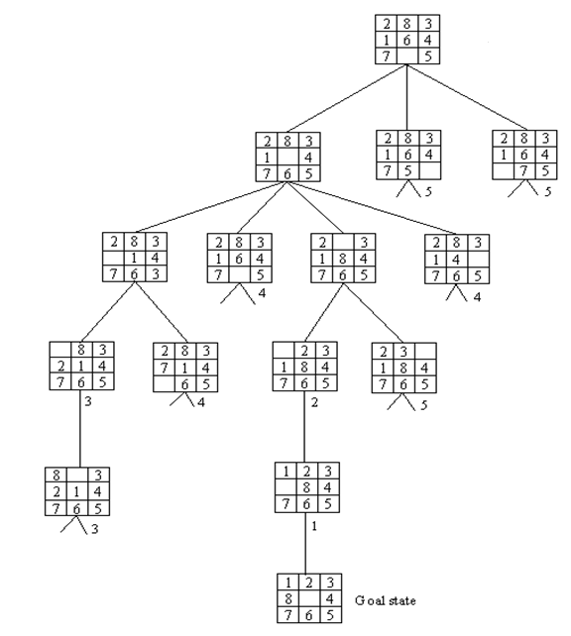
8-Puzzle -------------------------------

Slide 8
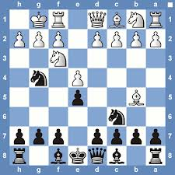
2. Can Solution steps be ignored or undone?
Irrecoverable problem: in which solution steps cannot be undone.
Ex:- Chess
Suppose a chess playing program makes a stupid move and realize it a couple of move later. It cannot simply play as though it never made the stupid move. Nor can it simply backup and start the game over from that point. All it can do is to try to make best of the current situation and go on from there.

Slide 9
2. Can Solution steps be ignored or undone?
Ignorable problem can be solved using a simple control structure that never backtracks. Such a control structure is easy to implement.
Recoverable problem can be solved by slightly more complicated control strategy that does something mistakes and backtracking will be necessary to recover from such mistakes.
Irrecoverable problems, solved by a system that expends a great deal of effort making each decision since each the decision must be final.
Some irrecoverable problems can be solved by recoverable style methods used in a planning process , in which an entire sequence of steps is analyzed in advance to discover where it will lead before first step is actually taken.

Slide 10
3. Is universe predictable?
Certain-outcome problem
Ex: 8-Puzzle
Every time we make a move, we know exactly what will happen. This is possible to plan entire sequence of moves and be confident that we know what the resulting state will be.
Uncertain-outcome problem
Ex: play Bridge
One of the decisions we will have to make is which card to play on the first trick. What we would like to do is to plan entire hand before making the 1st hand. But now it is not possible to do such planning with certainty since we cannot know exactly where all the cards are or what the other players will do on their turn.

Slide 11
4. Is a good solution Absolute or Relative ?
Any-path problem
Ex: Answer-question System
Consider the problem of answering the question based on following facts:
Marcus was a man.
Marcus was a Pompean.
Marcus was born in 40 AD.
All men are mortal.
All Pompeans died when volcano erupted in 79 AD.
No mortal lives longer than 150 years.
Now it is 1991 AD.
“ Is Marcus alive?”

Slide 12
4. Is a good solution Absolute or Relative ?
1. Marcus was a man - Axiom1
4. All men are mortal -Axiom4
8. Marcus is Mortal - 1&4
3. Marcus was born in 40 AD -Axiom3
7. Now it is 1991 AD -Axiom7
9. Marcus age is 1951 years - 3&7
6. No mortal lives longer than 150 years -Axiom6
10. Marcus is dead -6,8,9
Since all we are interested in is the answer to question, it does not matter which path we follow.
If we do follow one path successfully to the answer, there is no reason to go back and see if some other path might also lead to a solution.
OR
7. It is now 1991AD -axiom 7
5. All pompeians died in 79 AD -axiom 5
11. All pompeians are died now -7 & 5
2. Marcus was a pompeian -axiom 2
12. Marcus is dead -11,2

Slide 13
4. Is a good solution Absolute or Relative ?
Best-path problem
Ex: Traveling Salesman Problem
Given a road map of n cities, find the shortest tour which visits every city on the map exactly once and then return to the original city (Hamiltonian circuit)
Boston
New York
Miami
Dallas
S.F.
Boston
250
1450
1700
3000
New York
250
1200
1500
2900
Miami
1450
1200
1600
3300
Dallas
1700
1500
1600
1700
S.F.
3000
2900
3300
1700

Slide 14
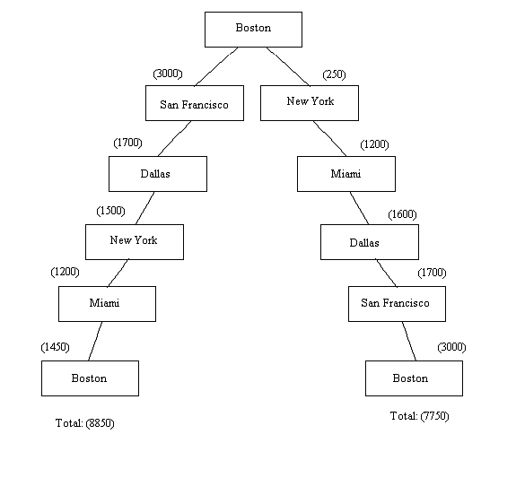

Slide 15
4. Is a good solution Absolute or Relative ?
Best-path problems are, in general, computationally harder than any-path problems.
Any-path problems can often be solved in a reasonable amount of time by using heuristics that suggest good paths to explore. If the heuristics are not perfect, the search for a solution may not be as direct as possible, but that does not matter.
For true best-path problems, however, no heuristic that could possibly miss the best solution can be used. So a much more exhaustive search will be performed.

Slide 16
5. Is the solution a State or Path ?
Solution is a path to state
Ex: Water jug problem
Here is not sufficient to report that we have solved the problem and the final state is (2,0).
Here we must report is not the final state but the path that we found to that state.
Thus a statement of solution to this problem must be a sequence of operations (some time called apian) that produce the final state.
Solution is a state of world
Ex: Natural language understanding
To solve the problem of finding the interpretation we need to produce interpretation itself. No record of processing by which the interpretation was found is necessary.
“The bank president ate a dish of pasta salad with the fork”.

Slide 17
6. What is the role of knowledge?
Knowledge is important only to constrain the search for solution
Ex: playing chess
Suppose you have ultimate computing power available.
How much knowledge would be required by a perfect program?
just the rule for determining legal moves and some simple control mechanism that implement an appropriate search procedure.
Knowledge is required even to be able to recognize a solution
Ex: Scanning daily news paper to decide which are supporting the democrates and which are supporting the republicans in some upcoming elections.
you have ultimate computing power available.
How much knowledge would be required by a perfect program?
This time answer is great deal. It would have to know:
The name of candidates in each party.
For supporting republicans; you want to see done is have taxes lowered.
For supporting democrats; you want to see done is improved education for minority students.
And so on......

Slide 18
7. Does the task require interaction with person?
Solitary:
in which the computer is given a problem description and produces an answer with no intermediate communication and with no demand for an explanation of the reasoning process.
Level of interaction b/w computer and user is problem-in solution-out.
EX: Theorem Proving
Conversational:
in which there is intermediate communication between a person and the computer, either to prove additional assistance to computer or to prove additional information to user, or both.
Ex: Medical diagnosis

Slide 19
Production System Characteristics
Production systems are a good way to describe the operations that can be performed in a search for a solution to a problem.
Can production systems, like problems, be described by a set of characteristics that shed some light on how they easily be implemented?
If so, what relationships are there b/w problem types and the types of production systems best suited to solve the problem.

Slide 20
1. Class of production Systems
A monotonic production system is a system in which the application of rule never prevents the later application of another rule that could also have been applied at the time that the first rule was selected.
A nonmonotonic production system is one in which this is not true.
A partially commutative production system is a system in with the property that if the application of particular sequence of rules transforms state x into state y, then any permutation of those rules that is allowable also transform state x in to state y.
A commutative production system is a production system that is both monotonic and partially commutative.

Slide 21
2. Relationship b/w problems and production systems
For any solvable problem, there exist an infinite number of production systems that describe ways to find solution. Some will be more natural or efficient than other.
Any problem that can be solved by any production system can be solved by a commutative one, but the commutative one may be so unwieldy as to be practically useless.
So in formal sense, there is no relation ship b/w kind of problems and kind of production system since all problems can be solved by all kinds of system.
But in practical sense, there definitely is such a relationships b/w kind of problems and kind of systems that lend themselves naturally to describing those problems.

Slide 22
2. Relationship b/w problems and production systems
Ignorable problems; where creating new thins rather than changing old once
Change occur but can be reversed and in which order of operation is not critical
 | Monotonic | Nonmonotonic
Partially Commutative | Theorem Proving | Robot Navigation, 8-puzzle
Not Partially Commutative | Chemical synthesis | Bridge, Chess
Reverse not possible and order matter.
where creating new things by changing old once

Slide 23

It is particularly important to make correct decisions the first time, although
Universe is predictable.

